Slide 1

Priority Queue
Yusif Imamverdiyev

Slide 2
TABLE OF CONTENTS
01
03
02
04
Stack
Priority Queue
Queue
HashSet<T>

Slide 3

INTRODUCTION
Mainly this type data structure is as same as Queue and Stack. This type of data structures are one dimension. And in the Priority Queue we will have priority variable. In another word in this type of data structures the element which is adding collection will have priority level and it placed in the first place

Slide 4

01
Stack

Slide 5
ABOUT Stack
Stack is one of the main data structures in the programming. Stack must have type and all elements have to be same type . Stack is working with LIFO logic. It means Last in first out. C# have generic Stack and non generic Stack collection classes. Let’s stack functions and how it is working .

Slide 6
Main Methods of Stack
Push (T)
Pop()
Peek (T)
Contains(T)
Clear(T)
Insert variable front of Stack
Return the first element and remove it
Return the first element
Finds element in Stack.
Delete all elements of stack

Slide 7
Let’s use stack methods
Push(“Apple”)
Apple
Banana
Peach
Strawberries
Oranges

Slide 8
Let’s use stack methods
Push(“Banana”)
Push(“Peach”)
Push(“Strawberries”)
Push(“Oranges”)
Banana
Peach
Strawberries
Apple
Oranges

Slide 9
Let’s use stack methods
TOP()
POP()
Peek()
Strawberries
Oranges
Strawberries
Strawberries
Strawberries
Peach
Peach
Peach
Banana
Banana
Banana
Apple
Apple
Apple

Slide 10
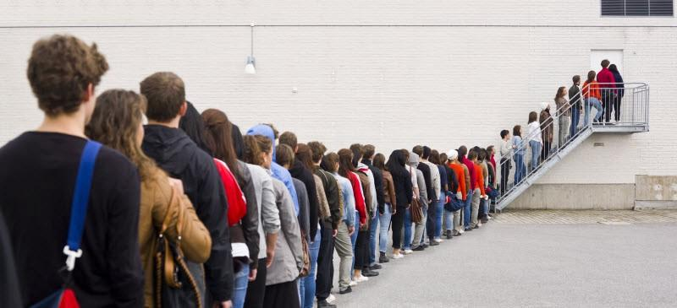
02
Queue

Slide 11
ABOUT Queue
We have already take a look stack and common methods of stack. Now we will learn “Queue”. Queue also most common data structure in programming. It is the opposite of Stack. It is FIFO style. First in First out .

Slide 12
Specs of Queue
Queue
Queue is a FIFO (First In First Out) collection.
It comes under the System.Collection.Generic namespace.
The queue can contain items of the specified type. It provides compile-time type checking and does not perform boxing-out of the box because it is generic.

Slide 13
Main Methods of Queue
Enqueue(T)
Dequeue()
Peek (T)
Contains(T)
Clear(T)
Insert variable front of Stack
Return the first element and remove it
Return the first element
Finds element in Stack.
Delete all elements of stack

Slide 14
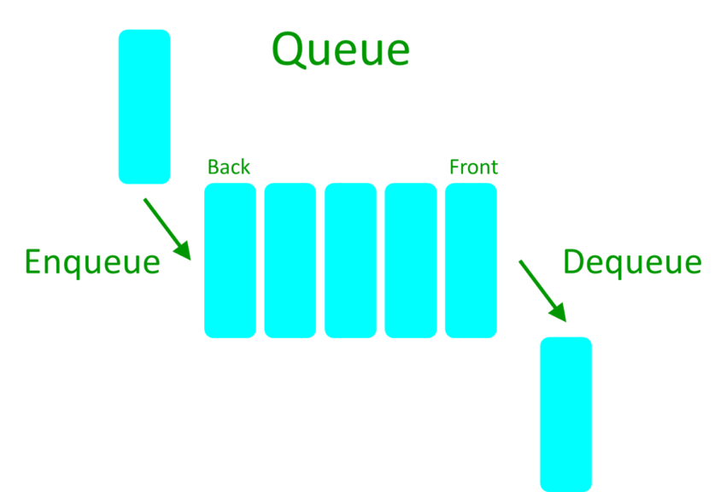
Let’s use queue methods

Slide 15
Let’s use stack methods
Push(“11”)
11
10
9
8

Slide 16
Let’s use stack methods
Push(“10”)
Push(“9”)
Push(“8”)
10
9
8
11

Slide 17
Let’s use stack methods
TOP()
POP()
Peek()
11
11
11
1
11
10
10
10
9
9
9
8
8
8

Slide 18

03
Priority Queue

Slide 19
ABOUT Priority Queues
We have already take a look stack and queue. Now we can look Priority Queue. It is as similar as Stack and Queue also it has priority level. It comes with .Net 6 . This data structure come from generic namespace als.

Slide 20
Why ?
Up to present inside of .Net have types which are works FIFO (Queue<T>) and LIFO (Stack<T>) logic. Unlike this types PriorityQueue<TElement,TPriority> give opportunity to sort the items according another priority , different from arrival time. Using this type , we can set up “producer-consumer” structures with special priority logic

Slide 21
Specs of Queue
Priority Queue
It takes two different generic parameter
One of them is type of items and other is priority level type
Priority queue uses quaternary min heap in internal implementation

Slide 22
Main Methods of Queue
Enqueue(T)
Dequeue()
Peek (T)
Contains(T)
Clear(T)
Insert variable front of Stack
Return the first element and remove it
Return the first element
Finds element in Stack.
Delete all elements of stack

Slide 23
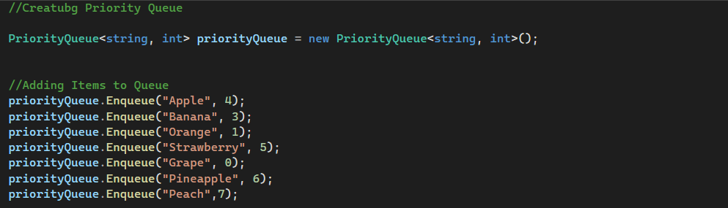

Slide 24
Item
Priority
Item
Priority
Apple
4
Grape
0
Peach
7
Orange
1
Grape
0
Apple
4
Orange
1
Peach
7

Slide 25
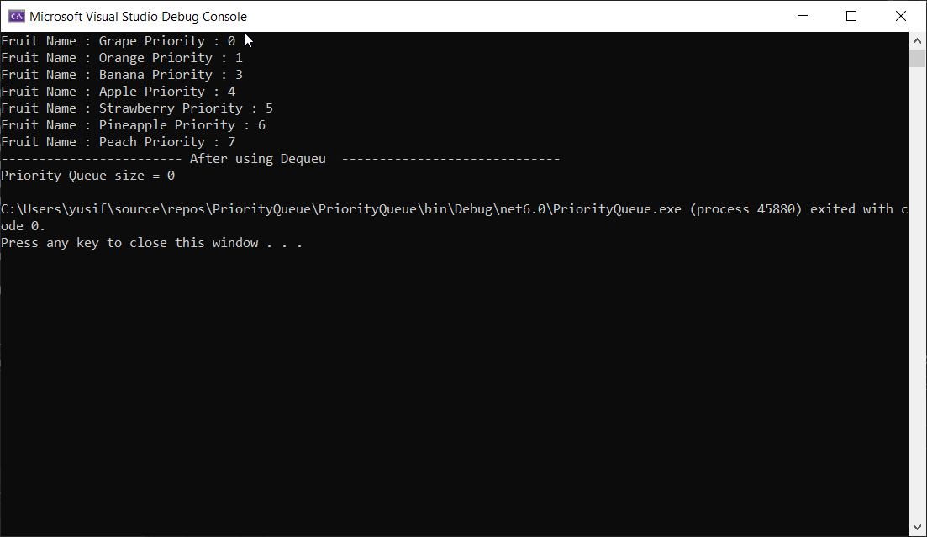

Slide 26
PriorityQueue<TElement,TPriority>.UnorderedItemsCollection Class

Slide 27
HashSet<T>

Slide 28
About content
Enumerates the contents of a PriorityQueue<TElement,TPriority>, without any ordering guarantees

Slide 29
Specs of Queue
HashSet
TElement
Tpriority
Inherit from PriorityQueue<TElement,TPriority>.UnorderedItemsCollection

Slide 30
Main Methods of HashSet
Equals(Object)
GetType()
GetEnumerator()
GetHashCode()

Slide 31

THANKS!
Do you have any questions?
yusif.pi@code.edu.az
Please, keep this slide for attribution.

